Slide 1
Fast R-CNN

Slide 2
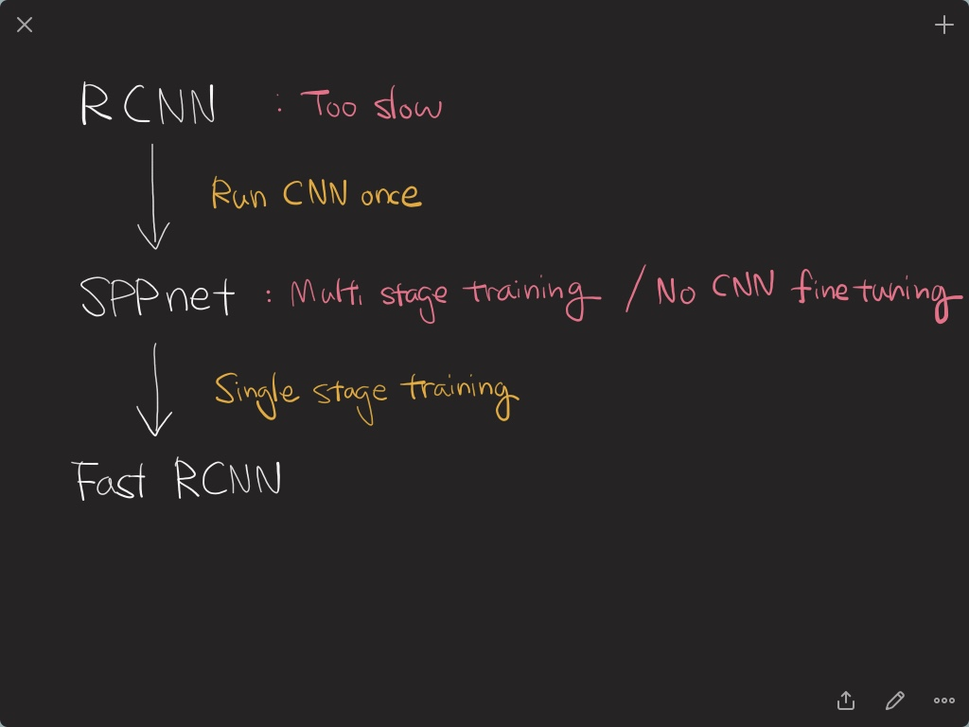

Slide 3
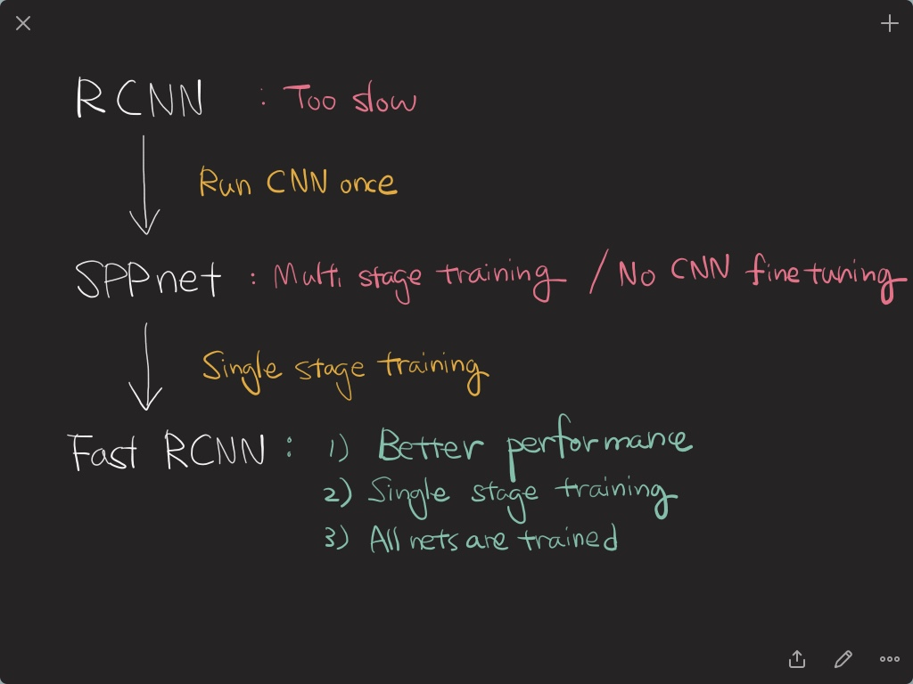

Slide 4
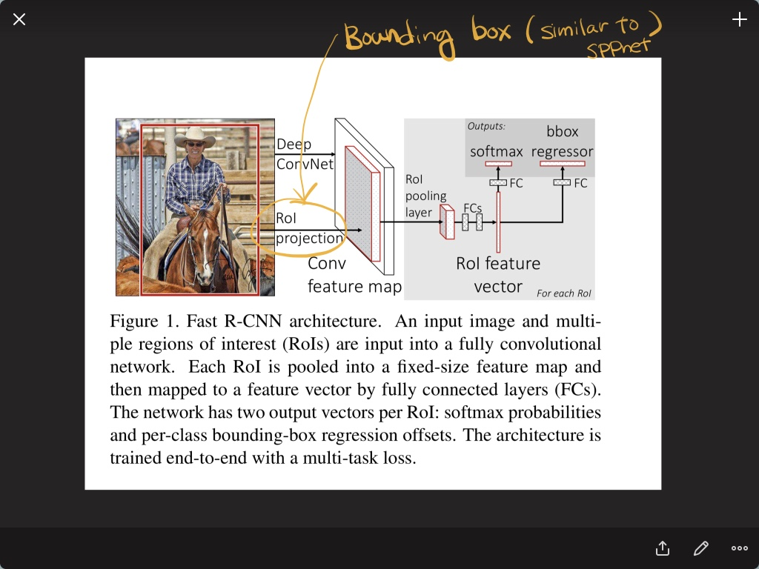

Slide 5
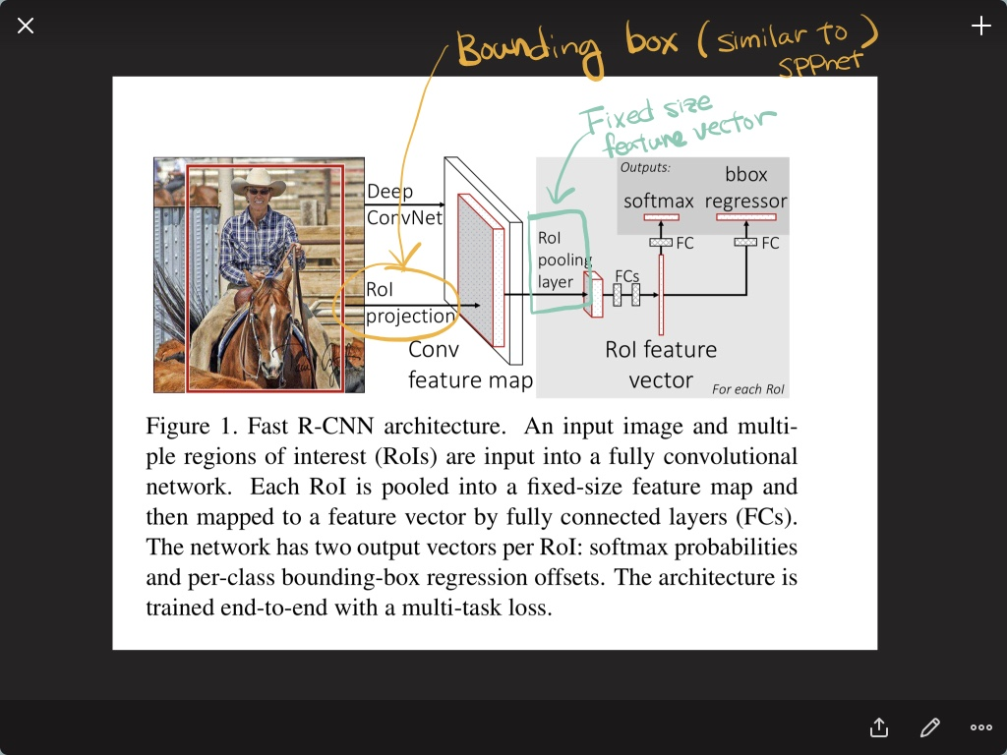

Slide 6
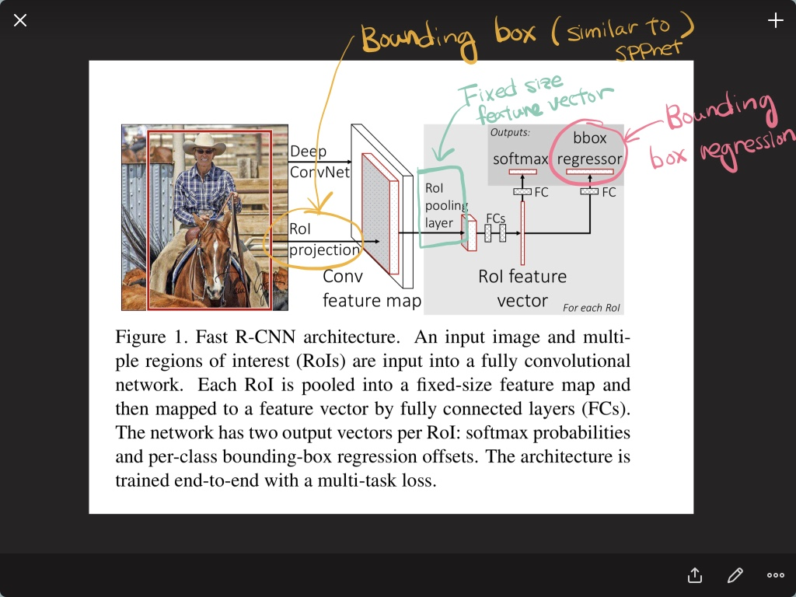

Slide 7
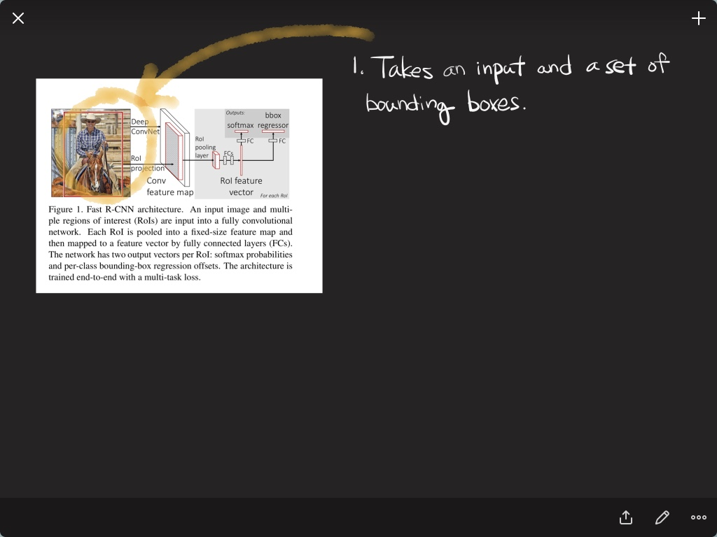

Slide 8
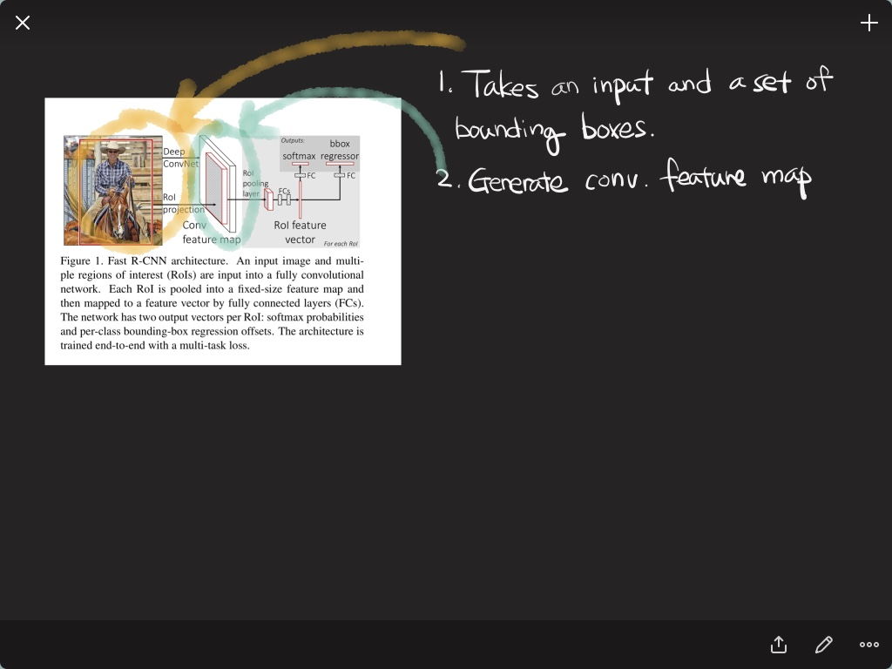

Slide 9
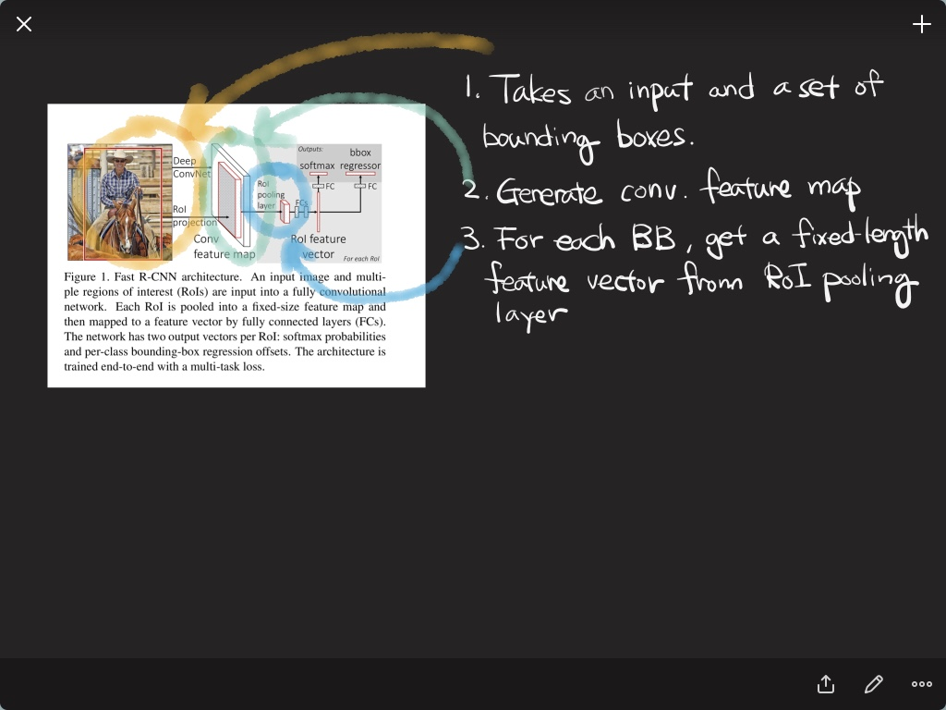

Slide 10
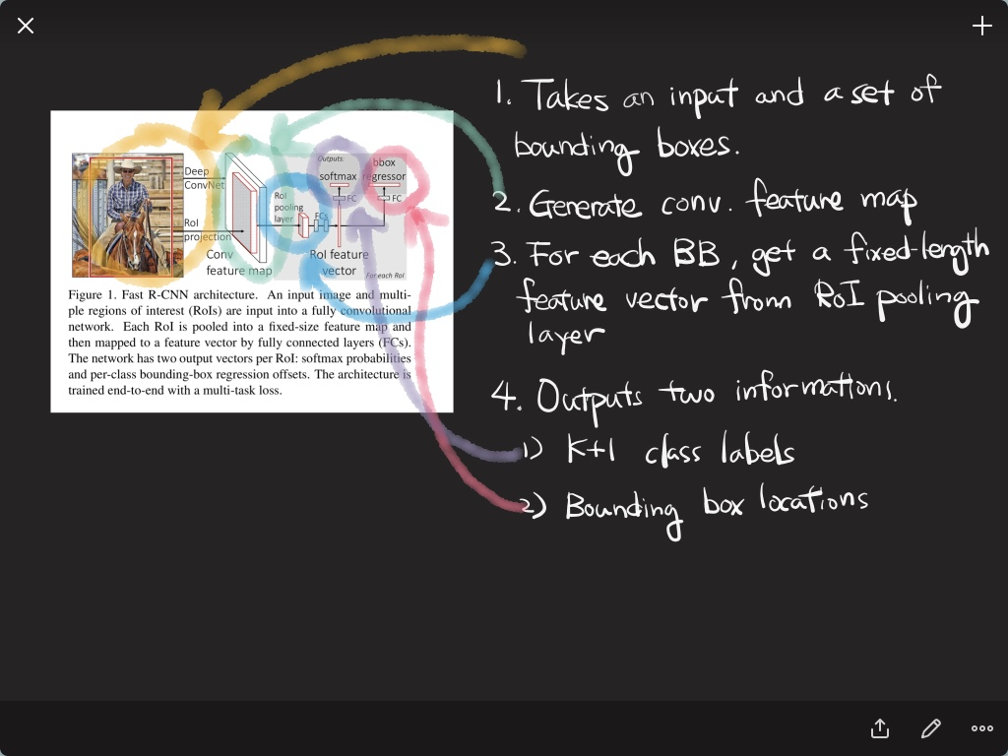

Slide 11
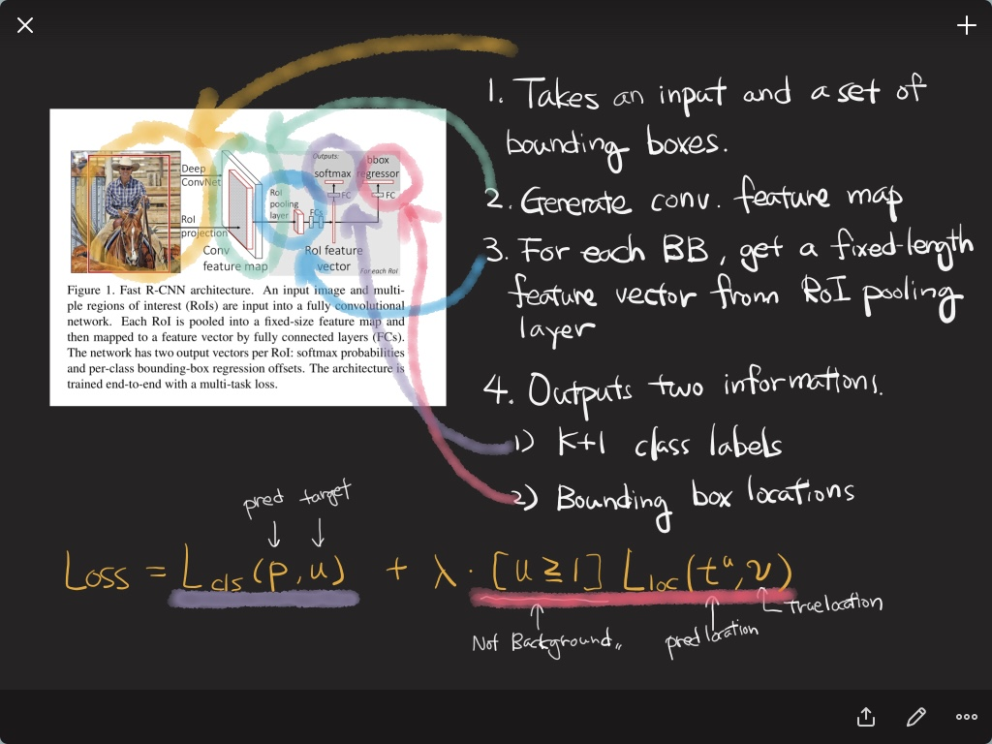

Slide 12
Faster R-CNN

Slide 13
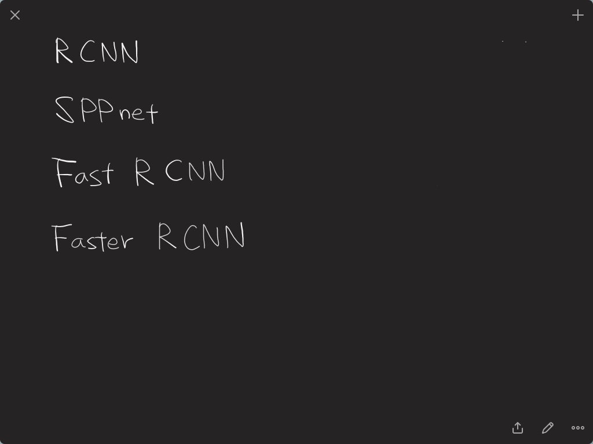

Slide 14
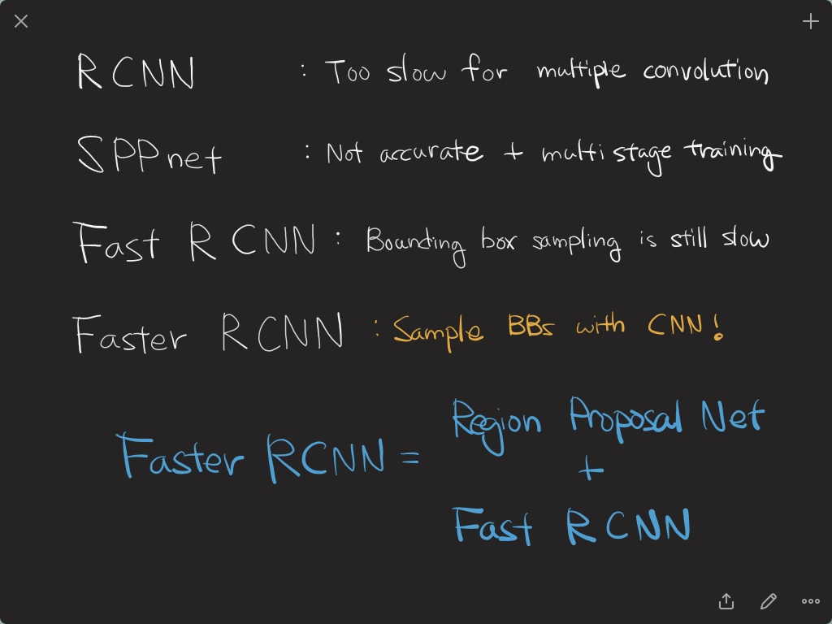

Slide 15
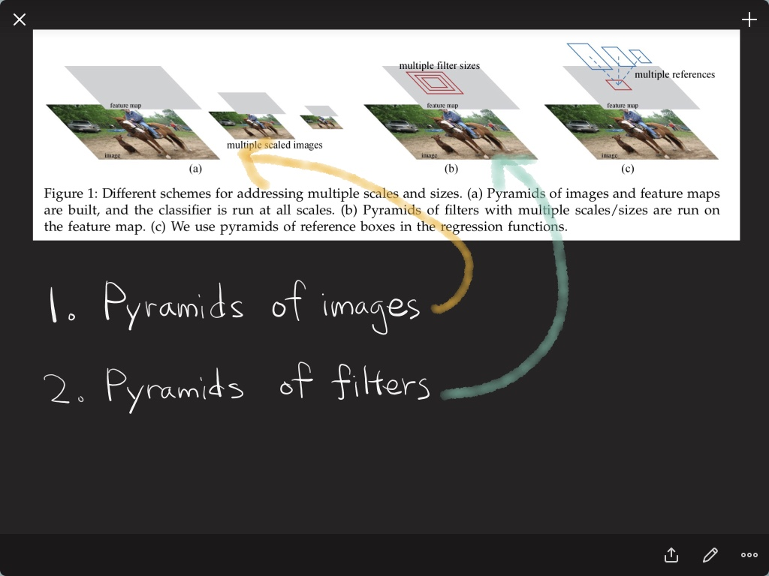

Slide 16
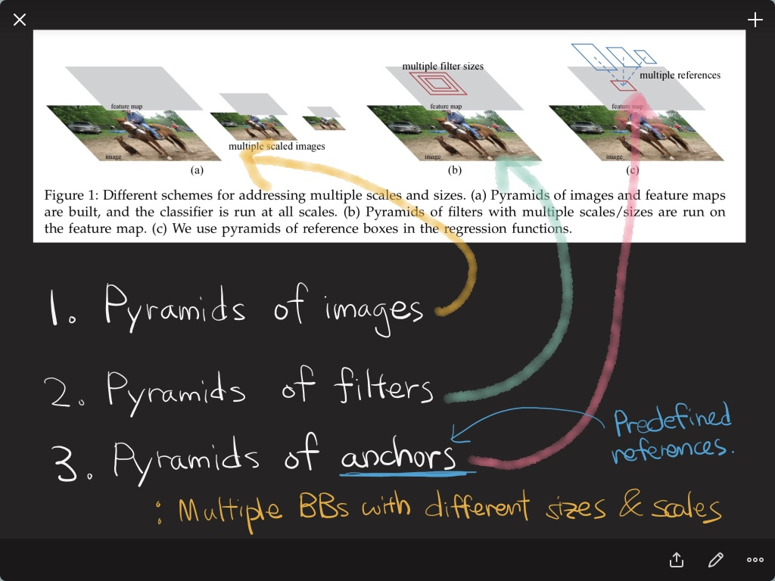

Slide 17
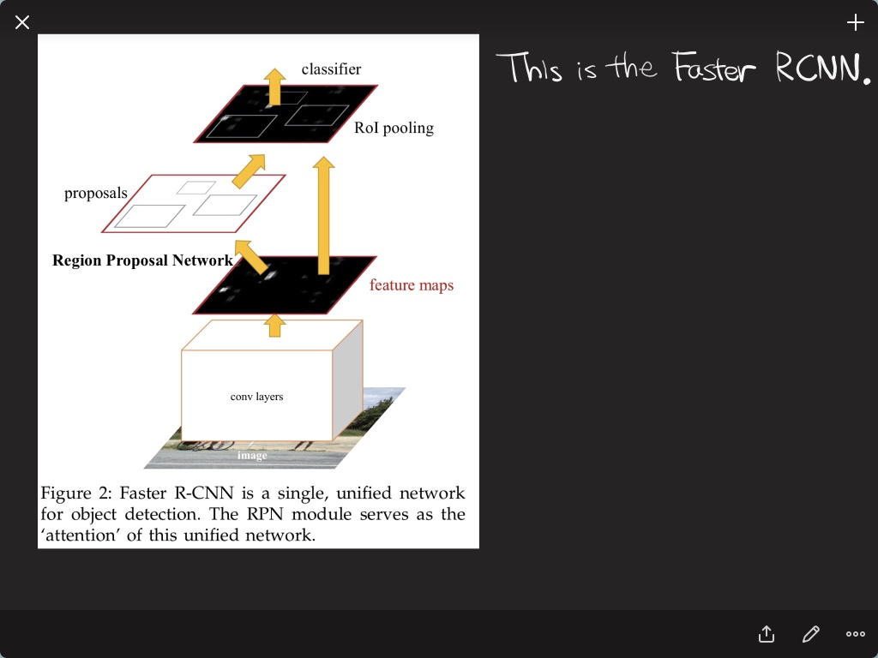

Slide 18
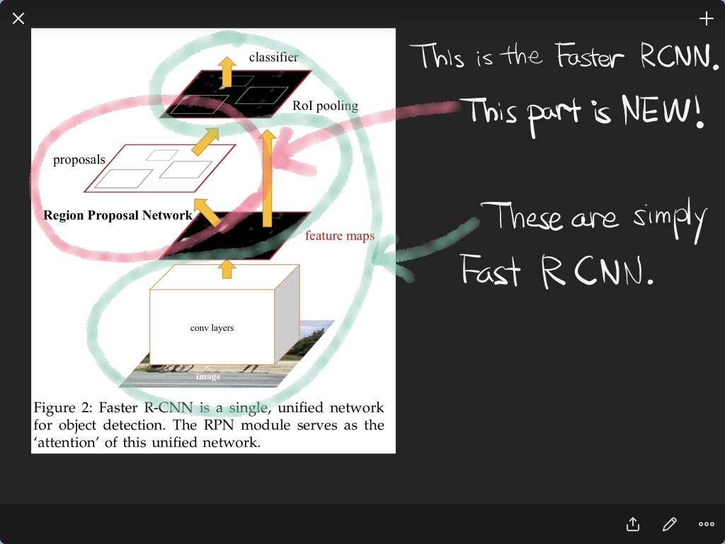

Slide 19
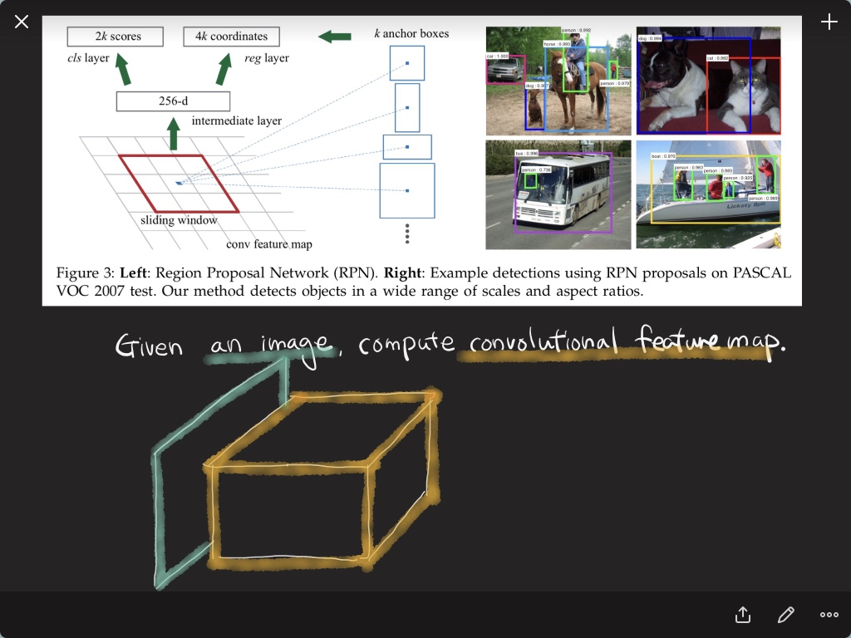

Slide 20
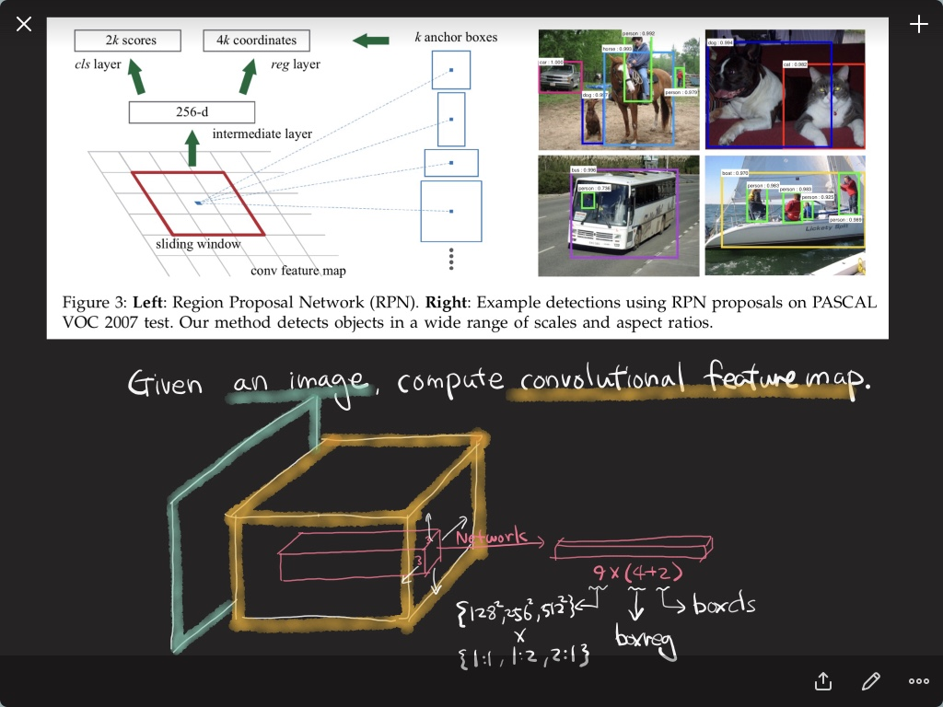

Slide 21
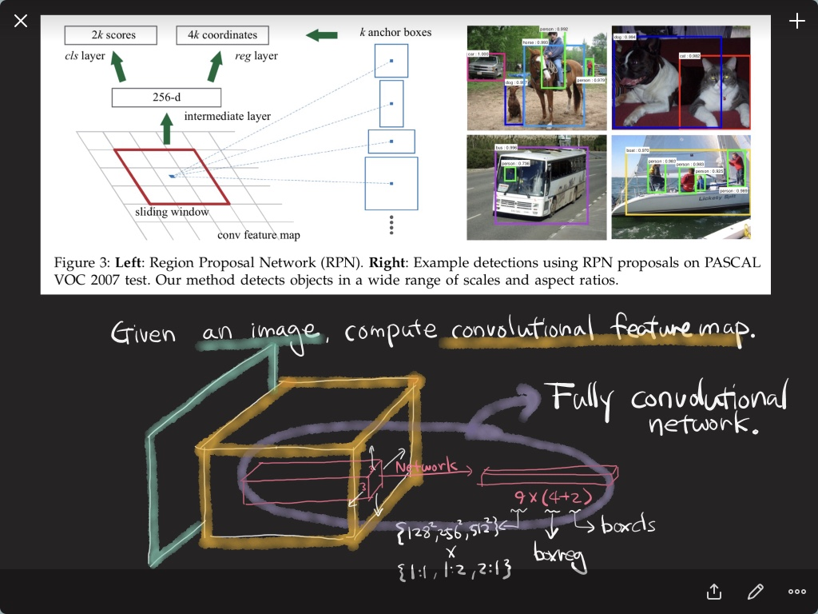

Slide 22
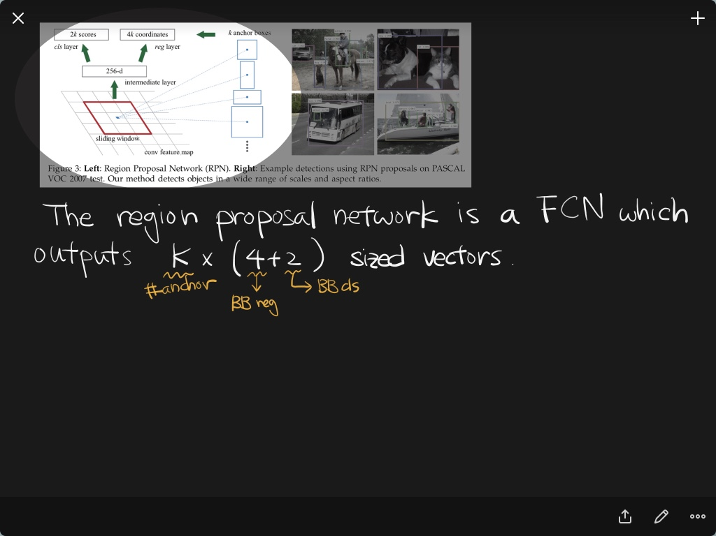

Slide 23
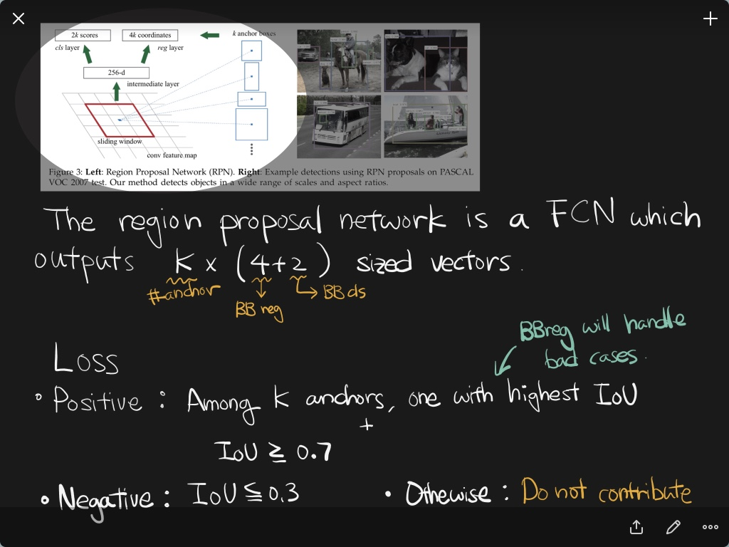

Slide 24
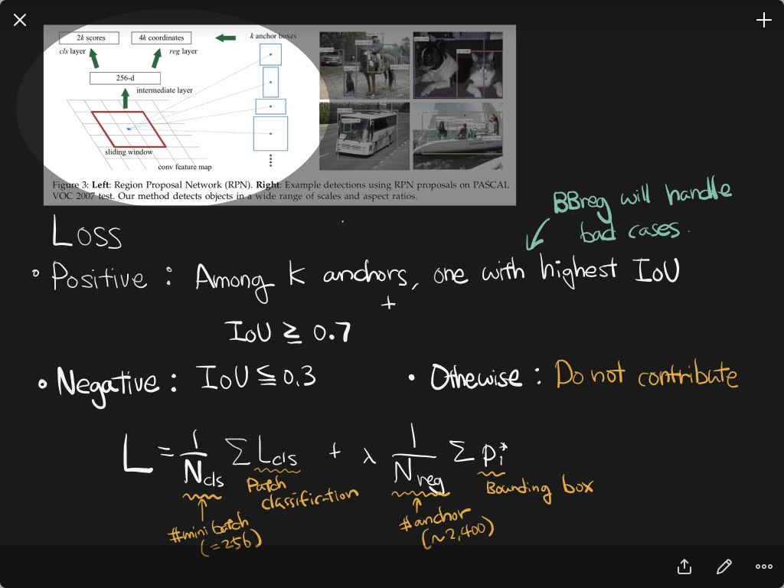

Slide 25
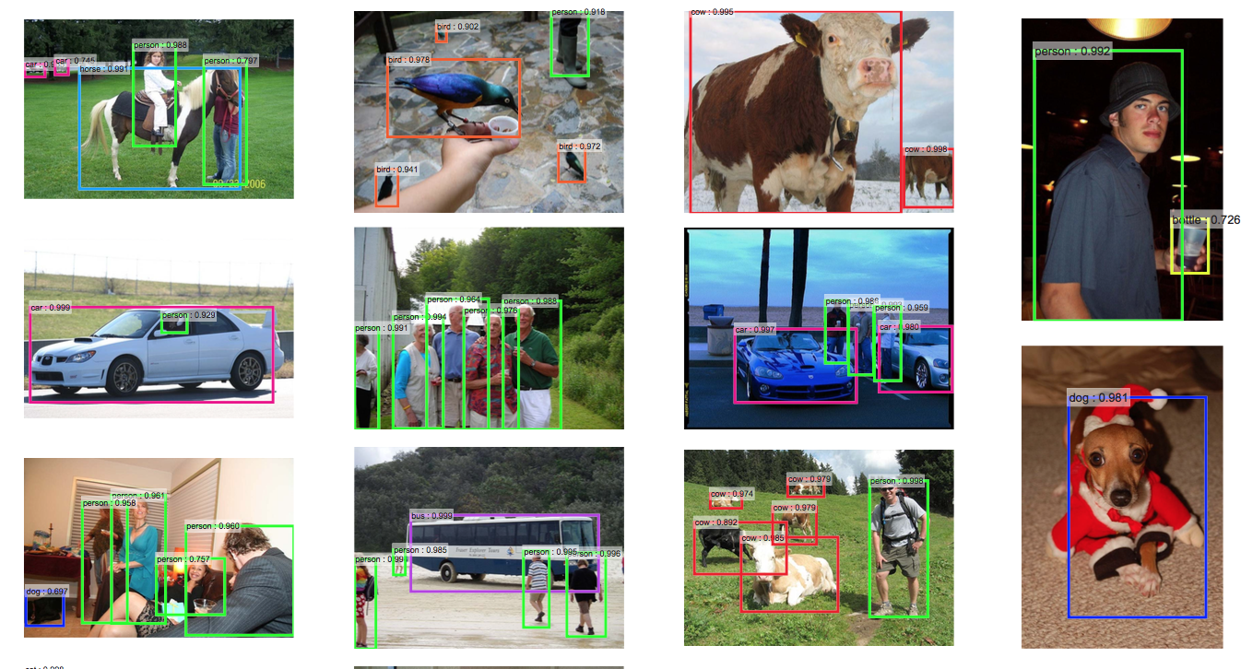
Results

Slide 26
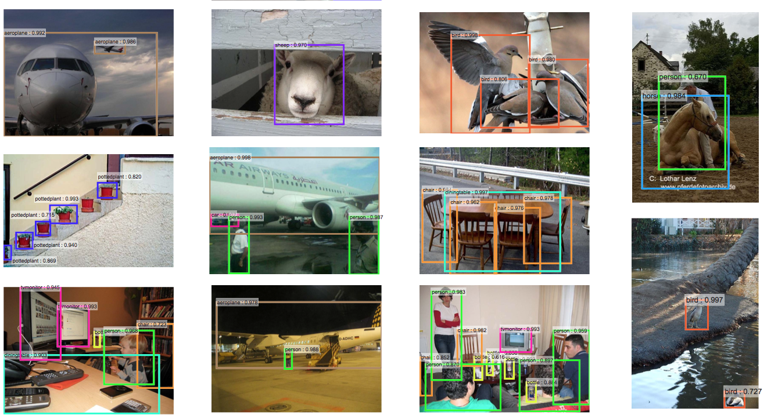
Results

Slide 27
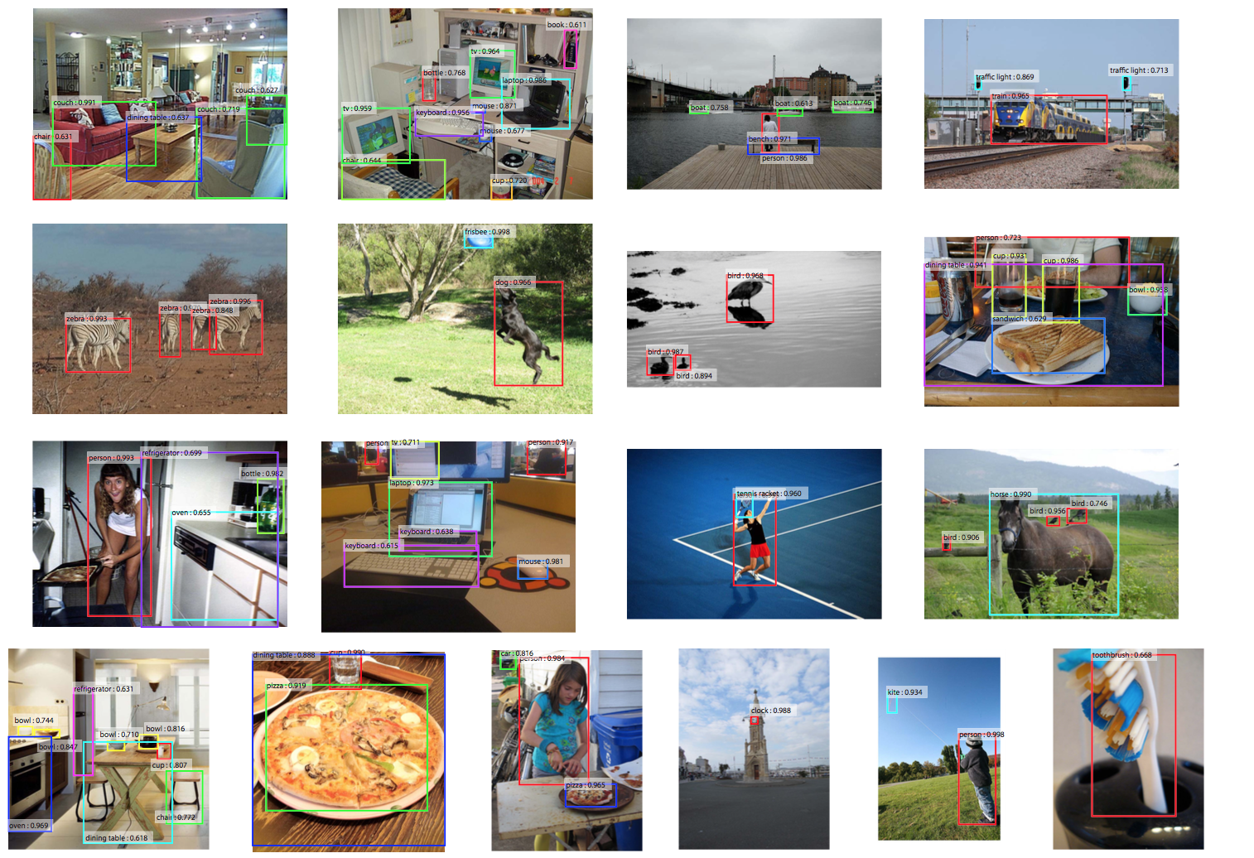
Results

Slide 28
R-CNN
Image
Regions
Resize
Convolution Features
Classify

Slide 29
SPP net
Image
Convolution Features
Regions
SPP
Classify

Slide 30
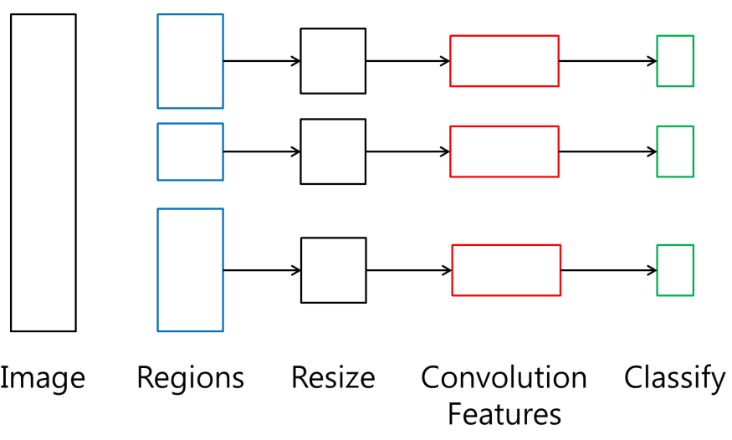
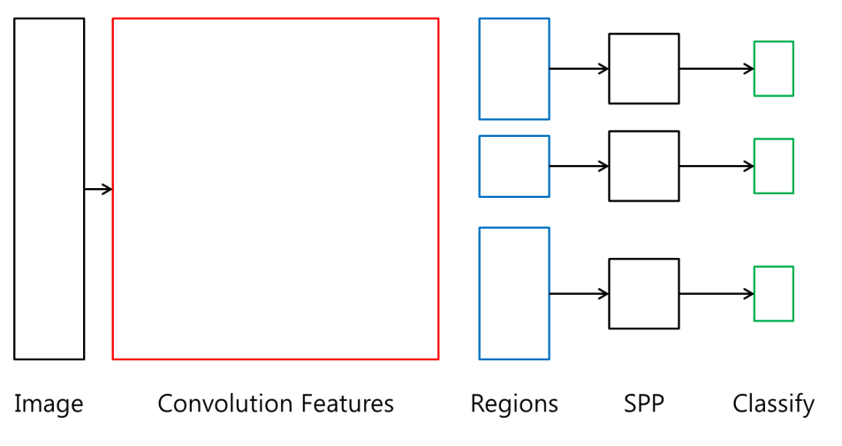
R-CNN vs. SPP net
R-CNN
SPP net

Slide 31
Fast R-CNN
Class Label
Convolution Features
RoI Pooling Layer
Confidence
Image
Class Label
Regions
RoI Pooling Layer
Confidence

Slide 32
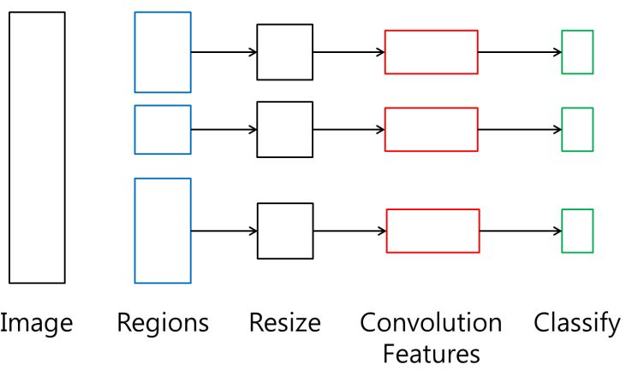

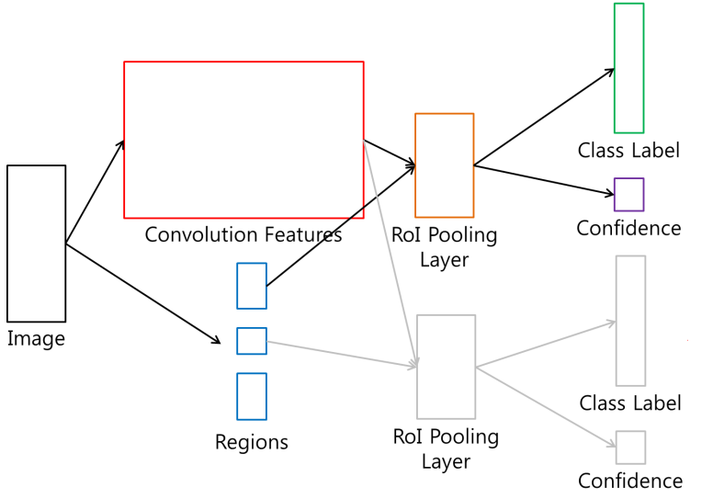
R-CNN vs. SPP net vs. Fast R-CNN
R-CNN
SPP net
Fast R-CNN

Slide 33
Faster R-CNN
Fast R-CNN
BB Classification
Image
Fully Convolutional Features
Bounding Box Regression

Slide 34
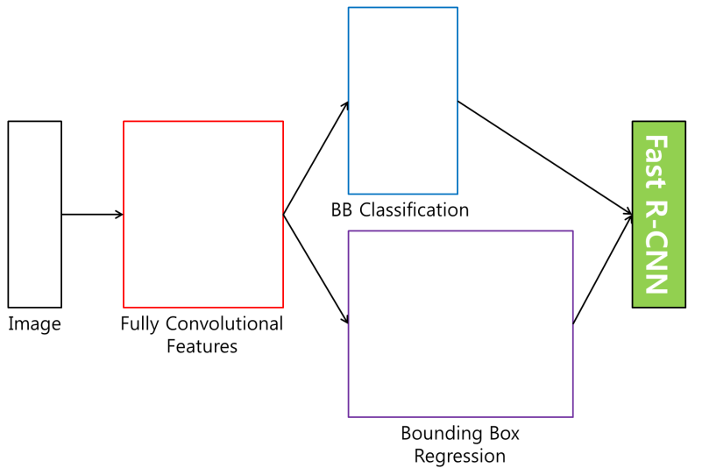
R-CNN vs. SPP net vs. Fast R-CNN
R-CNN
SPP net
Fast R-CNN
Faster R-CNN

Slide 35
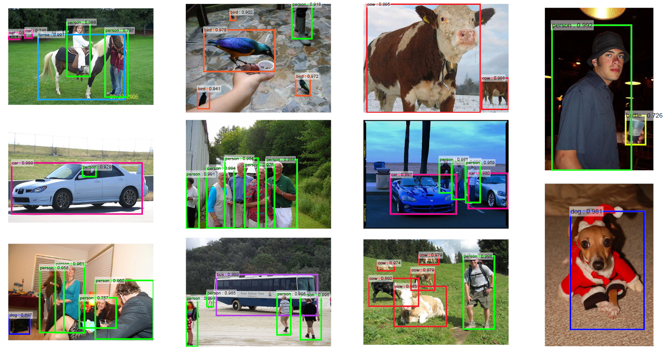
Results

Slide 36
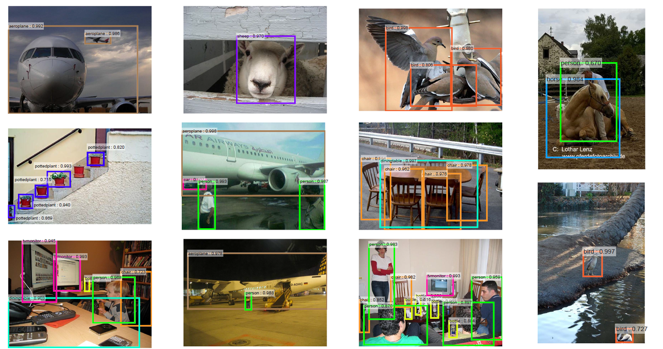

Slide 37
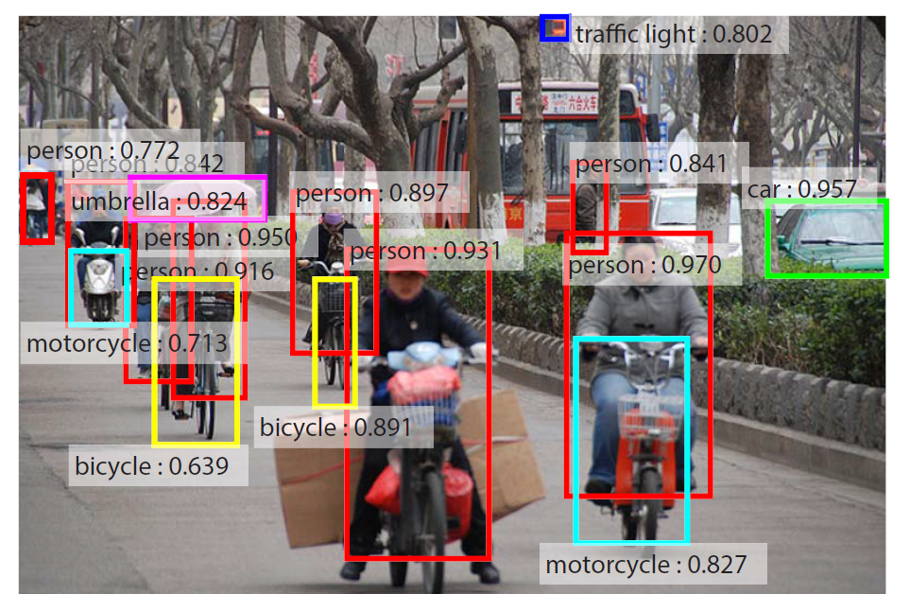

Slide 38
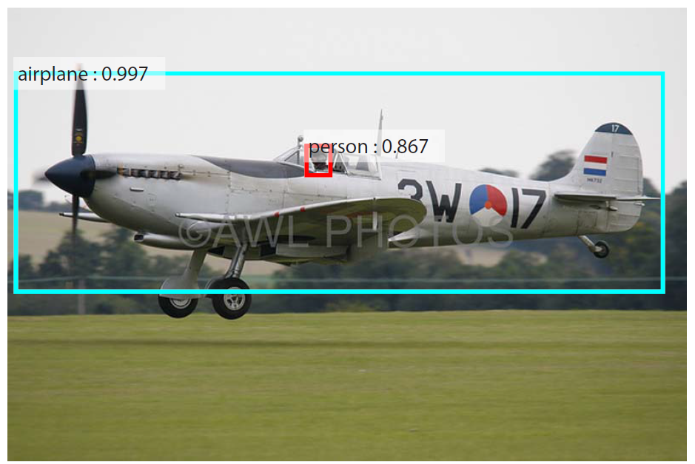

Slide 39
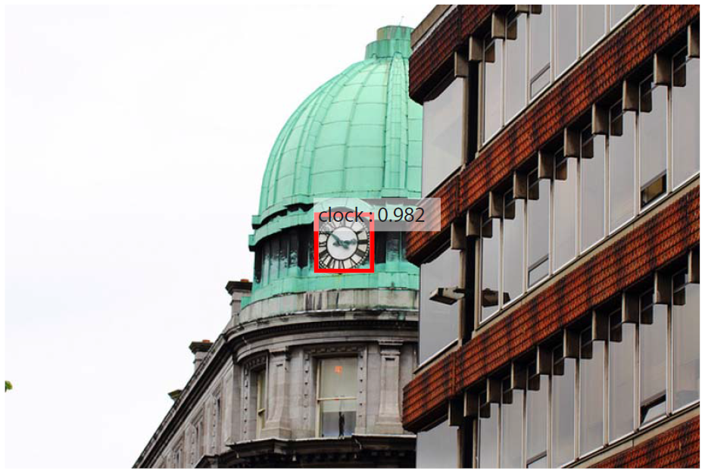

Slide 40
